Slide 1
Genital ducts
Associated with each testes are:
1-Epididymis or ductus epididymis
_long 5-7 m highly convoluted tubule.
_it is subdivided in to three regions, head, body and tail, the distal portion of the tail which stores spermatozoa for a short time
_Regularly lined by tall, absorptive, columnar cells with non-motile sterocilia, and smaller basal cells, together forming a pseudo stratified epithelium, the tall cell (principle) has function is as phagocytes remnants of cytoplasm that were not remove by sertoli cells, principle cells also manufacture glycerophosphocholine, a glycoprotein that inhibits spermatozoa capacitating, thus preventing the spermatozoa from fertilizing a secondary oocyte until the sperm enters the female genital tract.
_Out side the basal lamina is a little smooth muscle and, between the coils, is a stroma of dense c t with capillaries.

Slide 3
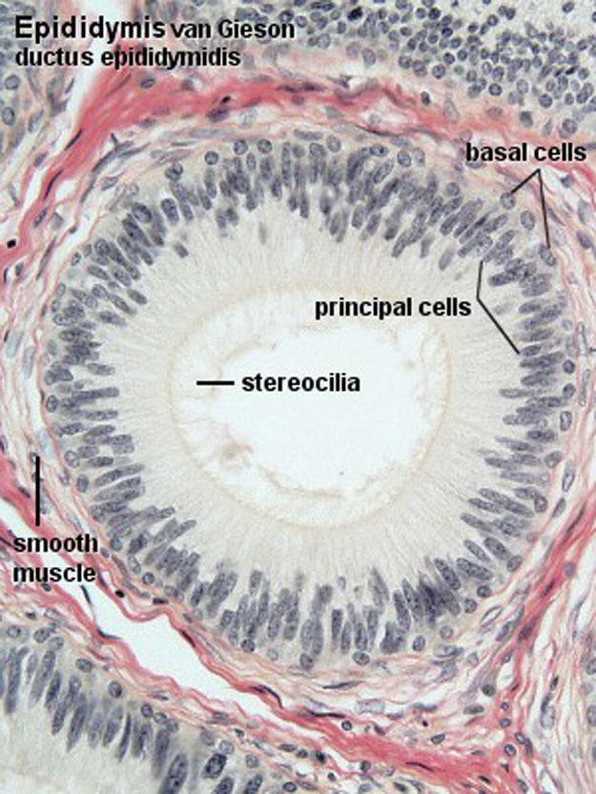
MALE REPRODUCTIVE SYSTEM
• EPIDIDYMIS
Notes:
7

Slide 4
2-Ductus deferens (Vas deferens)
_Lined by an epithelium similar to that of the epididymis with sterocilia, a lamina propria in the ampulla, this mucosa has many folds.
_Very thick walled muscular tube with small, irregular lumen that conveys spermatozoa from the tail of the epididymis to the ejaculatory duct.
_A basal lamina separates the epithelium from the underlying ct.
_Very thick wall three layers of smooth muscle, inner longitudinal, outer longitudinal and middle circular.
_Adventitia of ct binds it to nerves, blood and lymphatic vessels to comprise the spermatic cord.
_Function-rapid transport of sperm during ejaculation under sympathetic control.

Slide 6
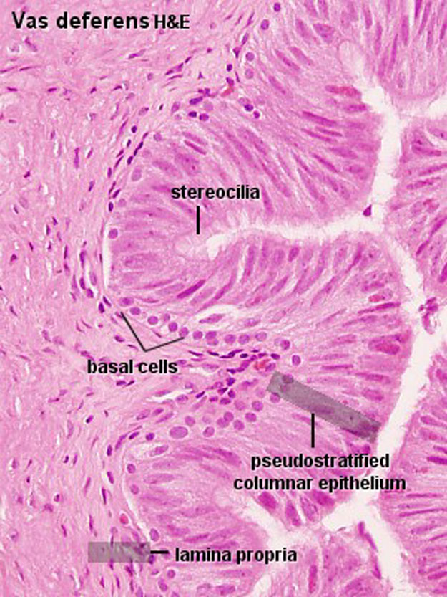
MALE REPRODUCTIVE SYSTEM
• VAS DEFERENS
Notes:
9

Slide 7
3-Ejaculatory ducts
_Each occurs after a dilation of the ductus deferens.
_Lined by pseudo stratified or simple columnar epithelium on ct, without smooth muscle.
_Ducts converge to open in to the prostatic urethra.
4-Rete testes:
Highly anatomosing network of tubules lie within the mediastinum testes lined by cuboidal epithelium with microvilli surrounded by ct.
5-Efferent ducts or ductuli efferentes:
_about 12-15 spiral ducts, join the channel of rete testes to ductus epididymis.
_lined by simple columnar epithelium cells ciliated, the wall has circular smooth muscle.
_function-reabsorption of the fluid used to move sperm out of the testes, maturation of the sperm.

Slide 8
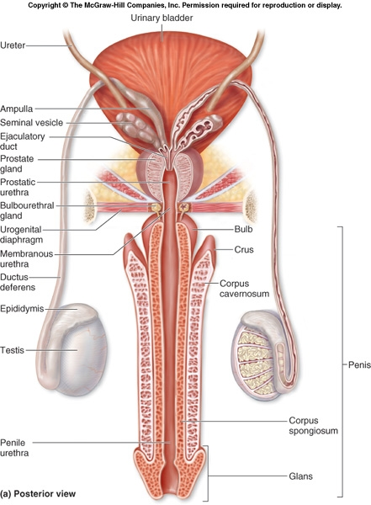
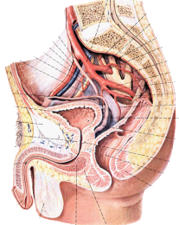
MALE REPRODUCTIVE SYSTEM

